Slide 1
Parasols 2023

Slide 2
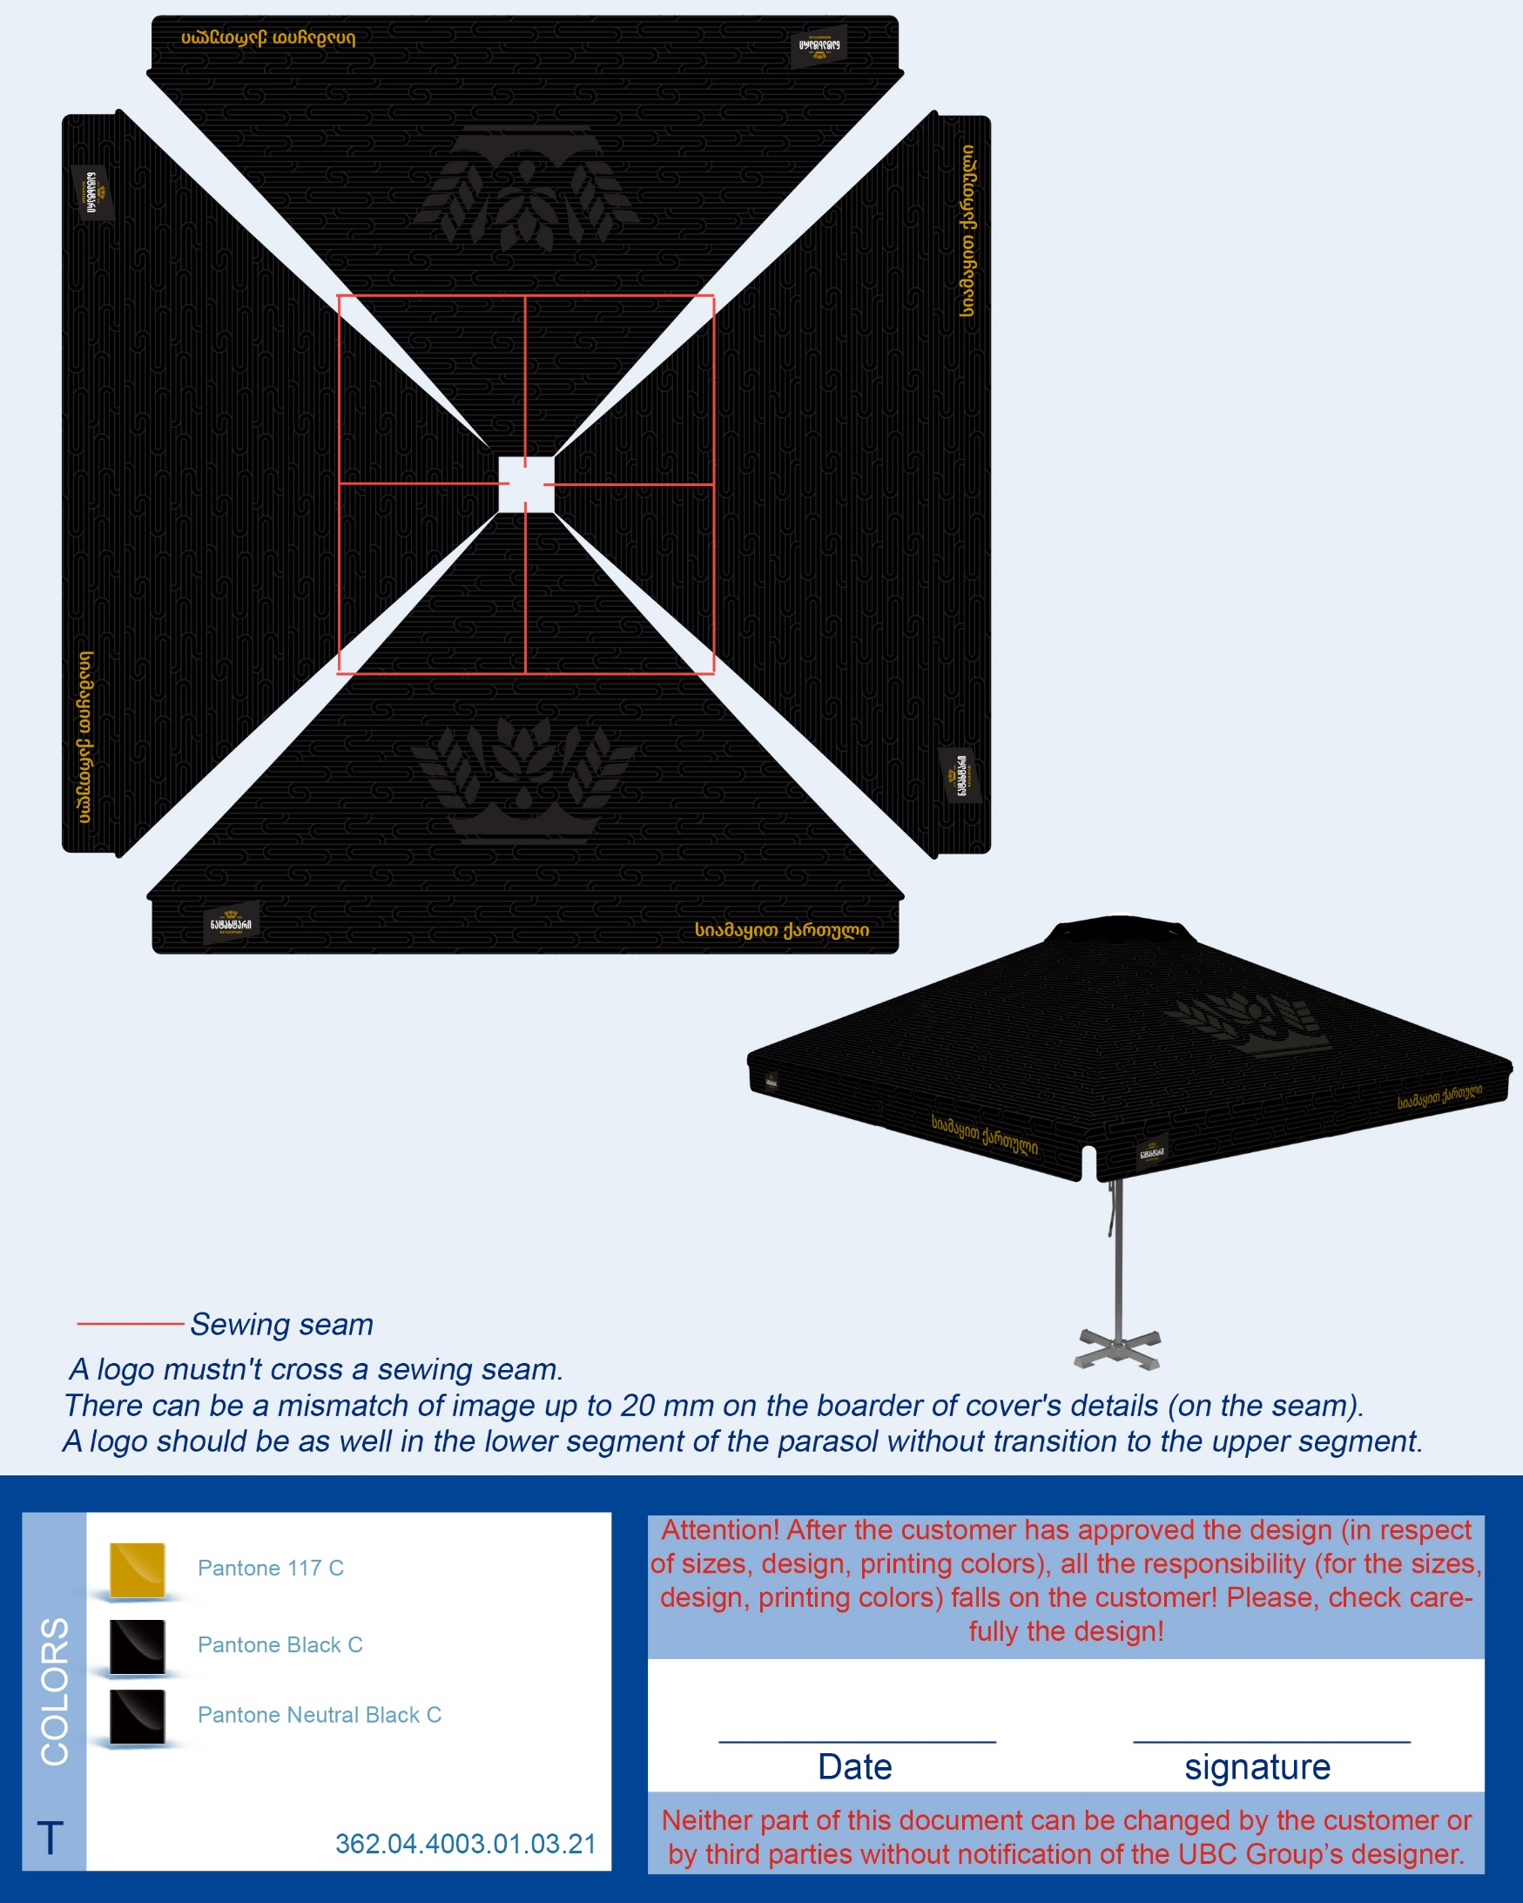
Natakhtari
3x3 Tulip type- 75 pcs (According to shown design)
Umbrella 4x4 - 325pcs
3m Diameter - 50 pcs

Slide 3
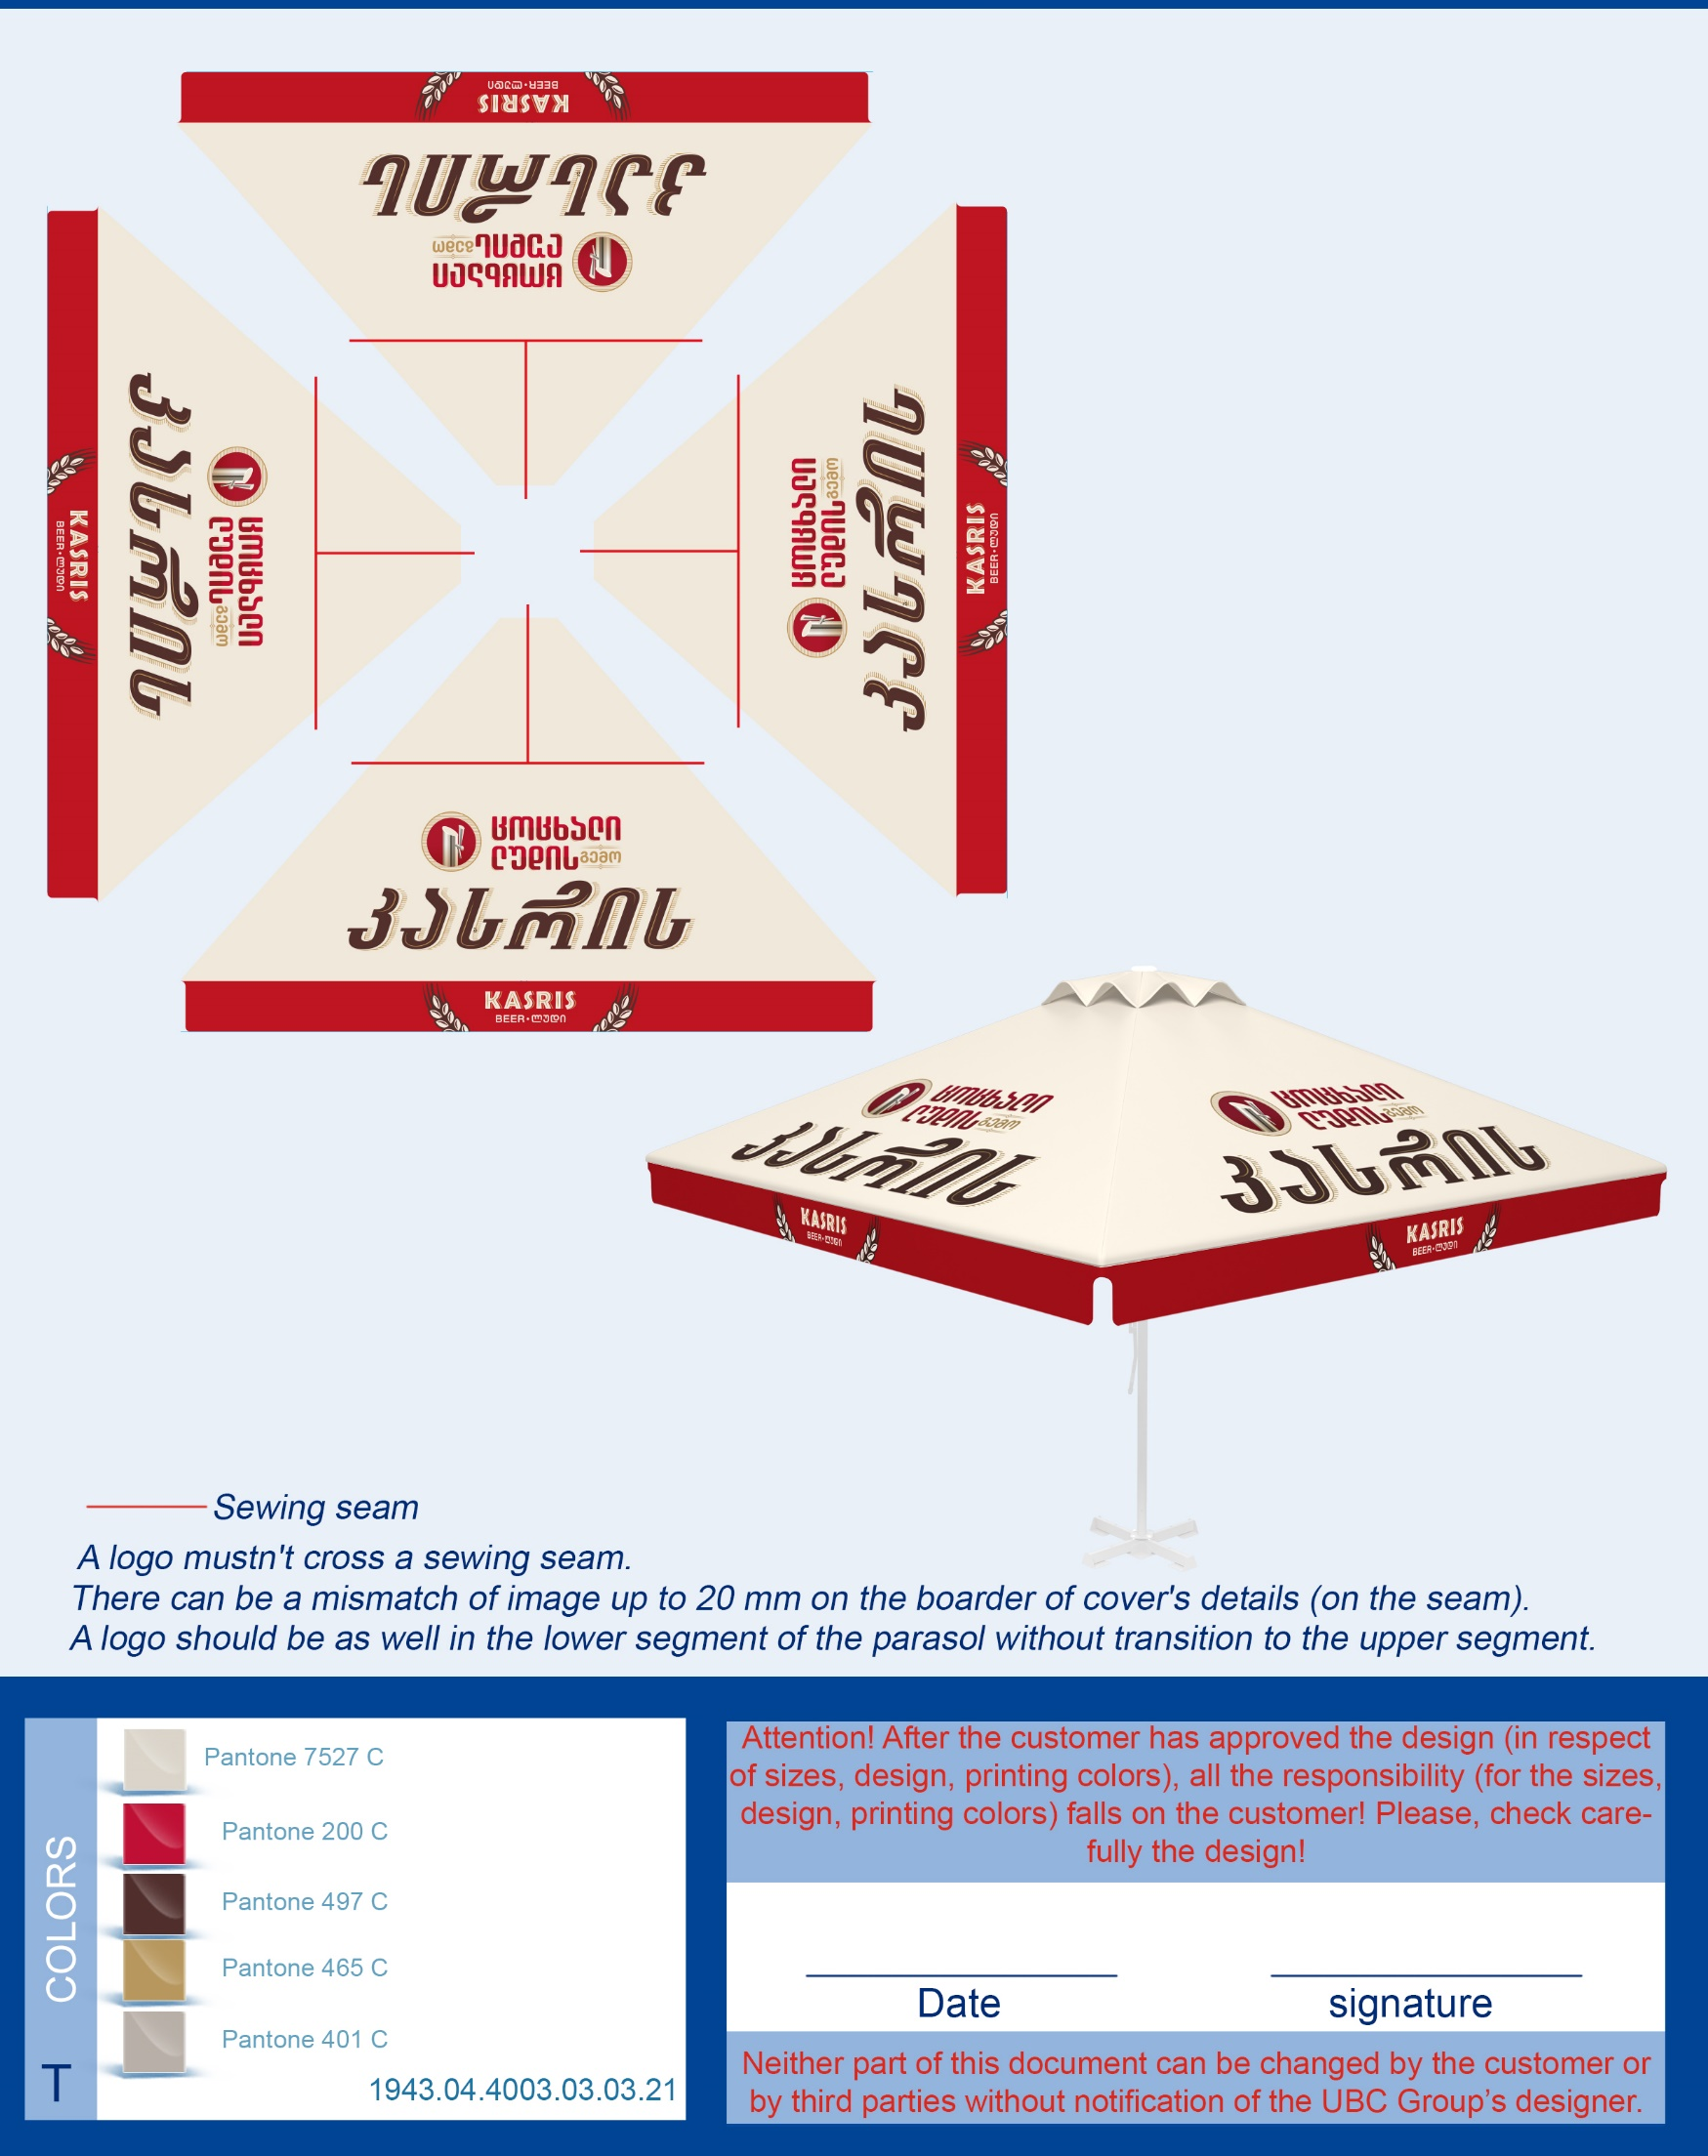
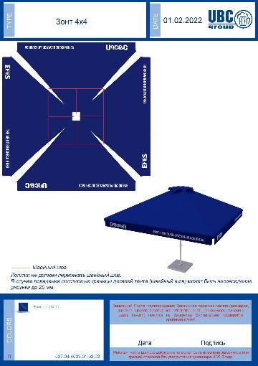
Kasris, EFES
4x4m - 35 pcs
1.8 m - 40 pcs (Photo is for checking the colors and general design)

Slide 4
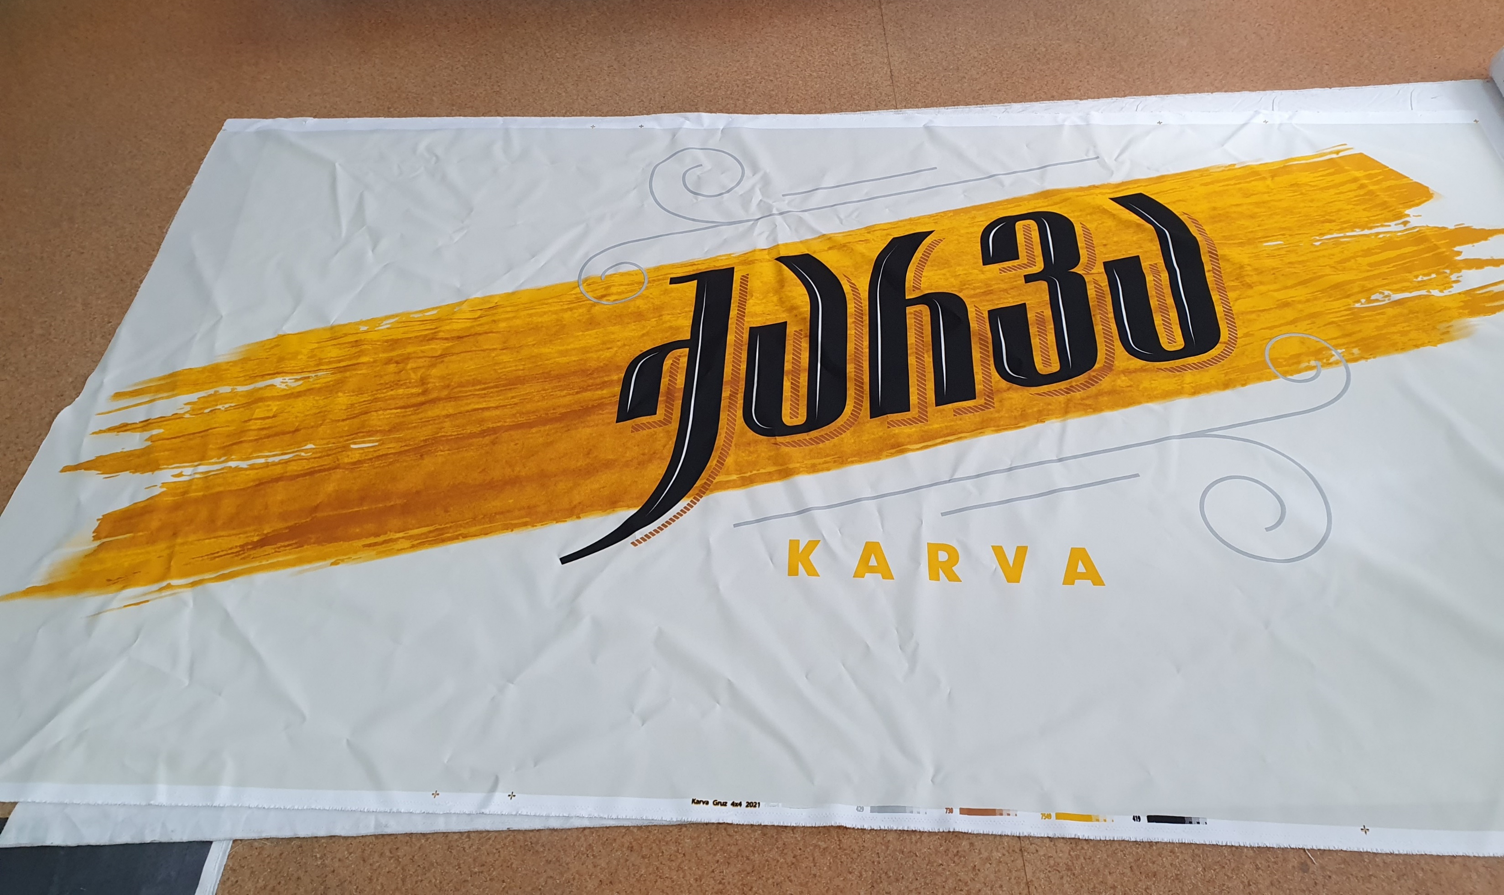
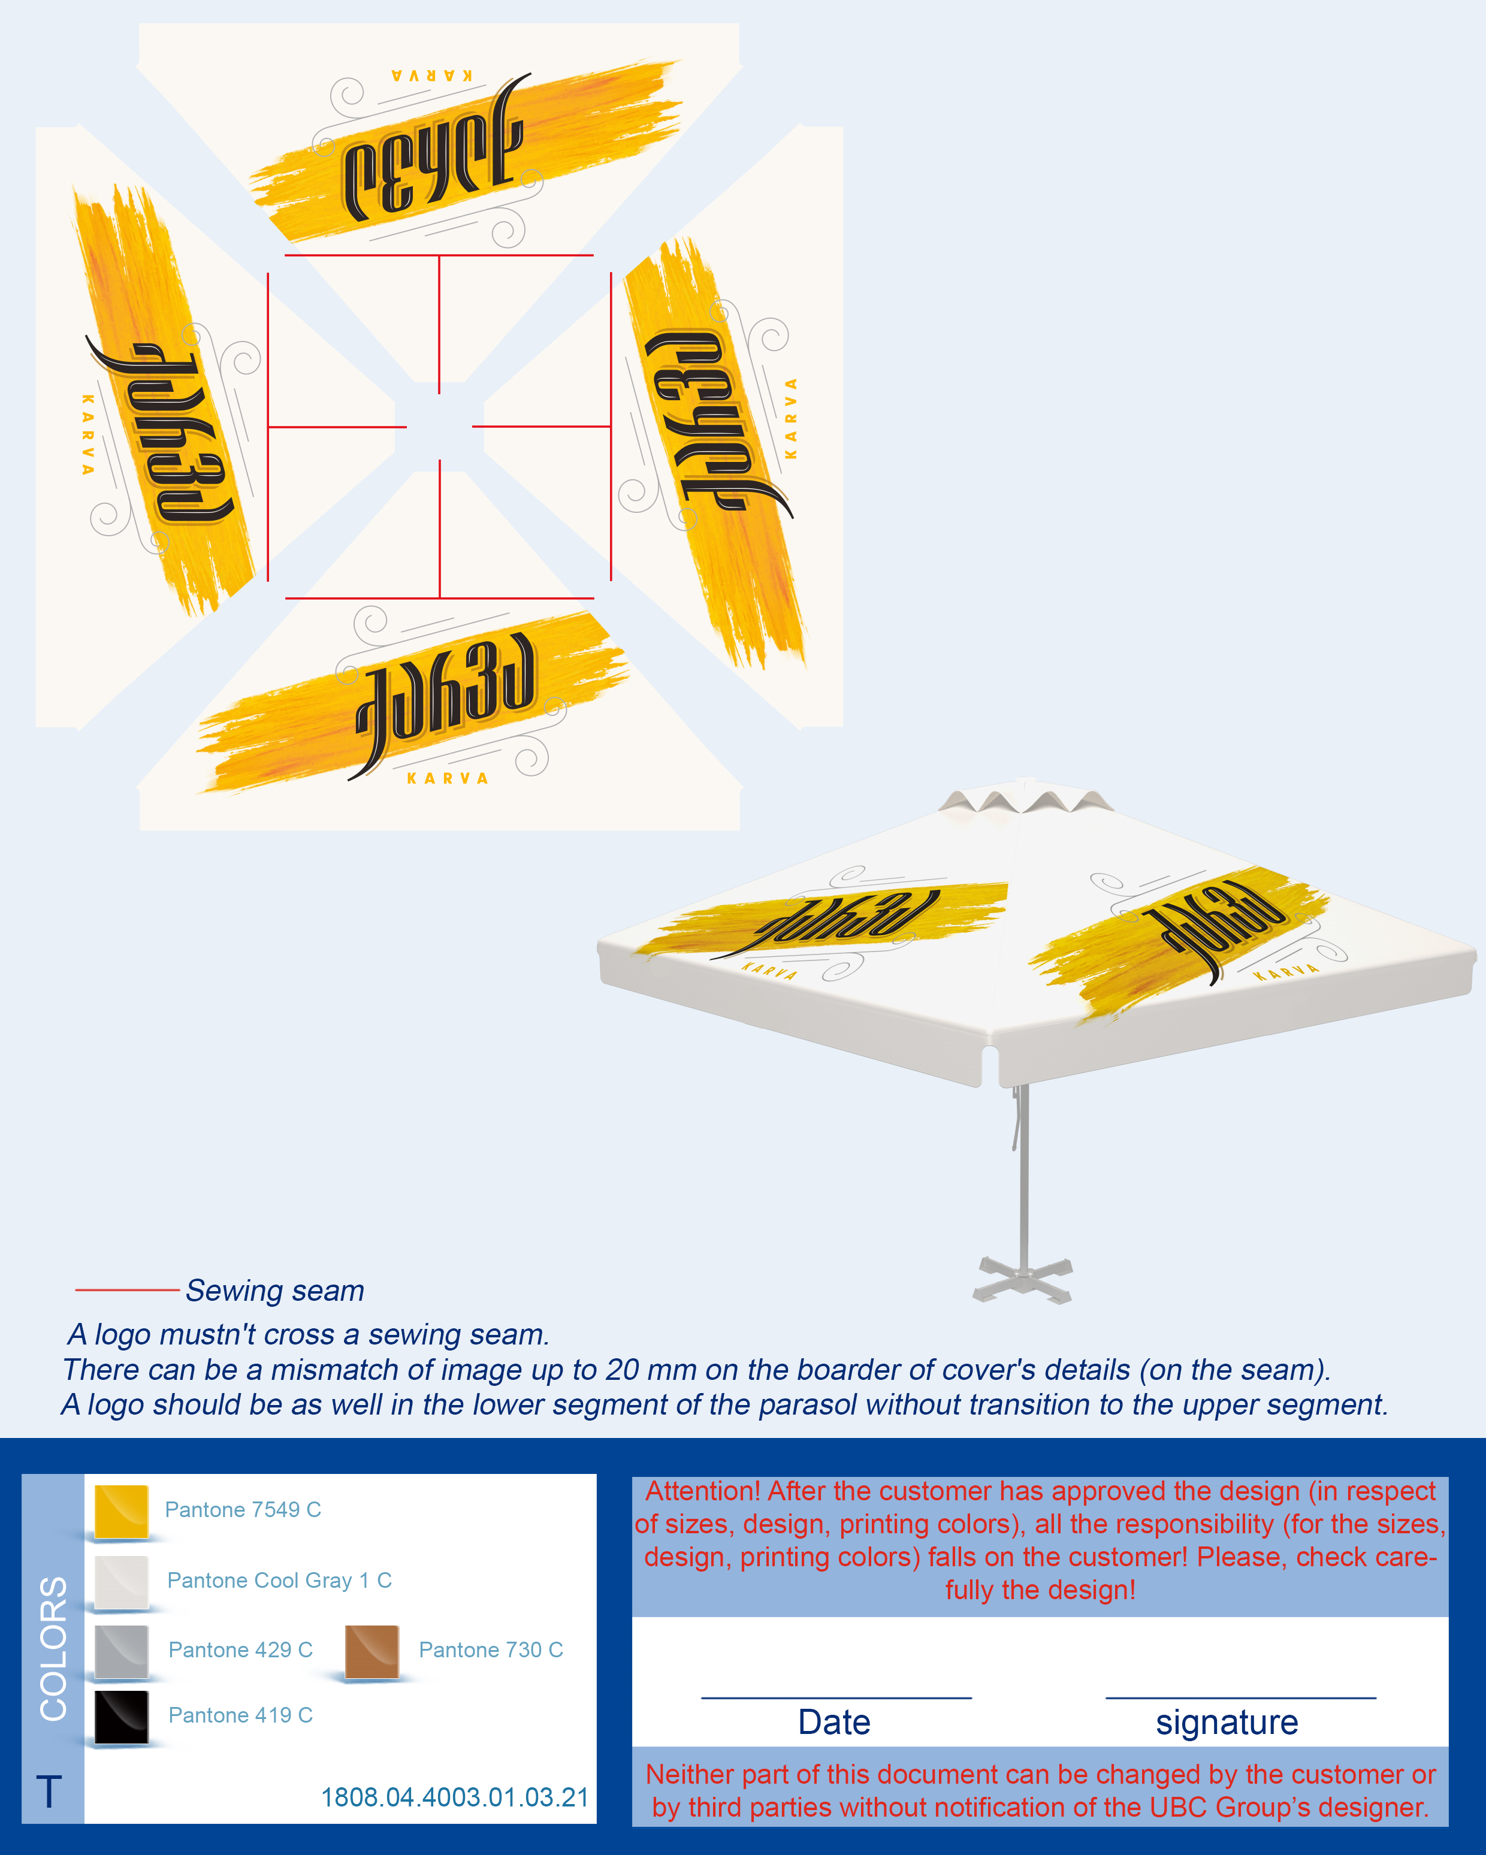
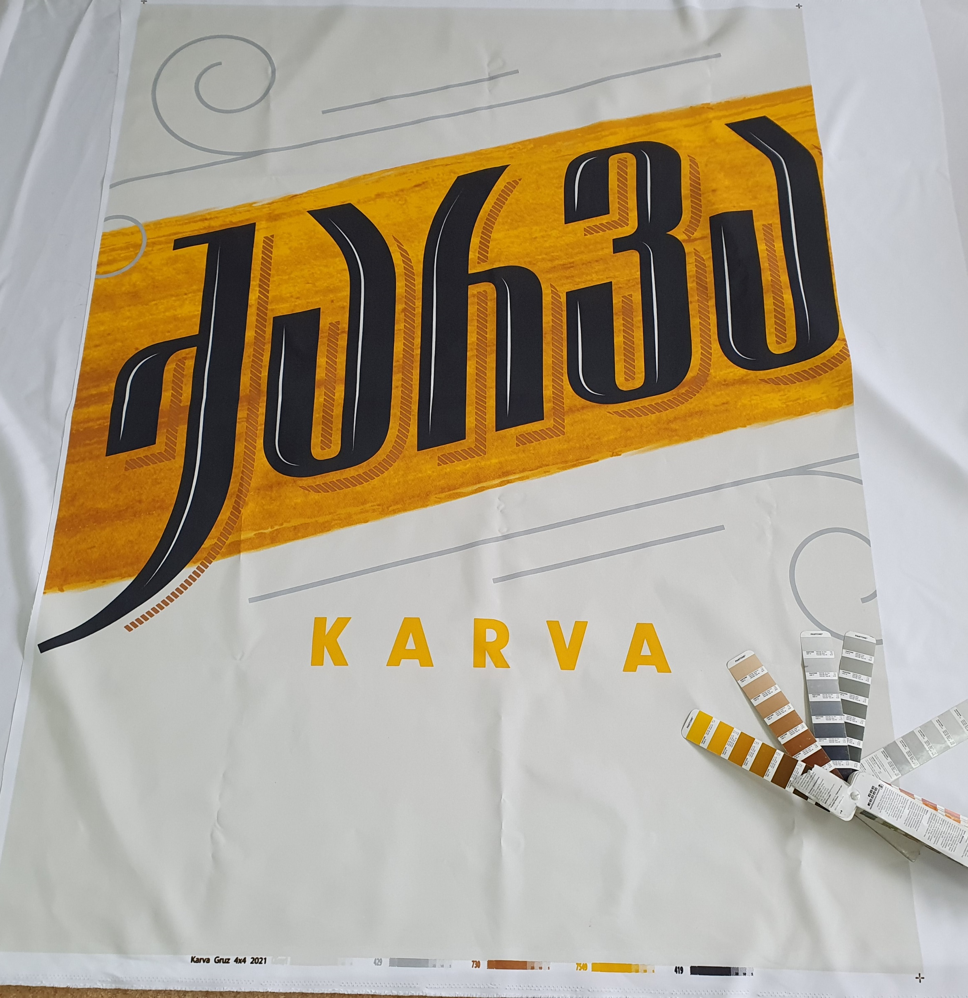
Karva (Parasols and TENTS only)
TENT 1.8m according to above design - 87 pcs
Parasol 4x4 - 20 pcs

Slide 5
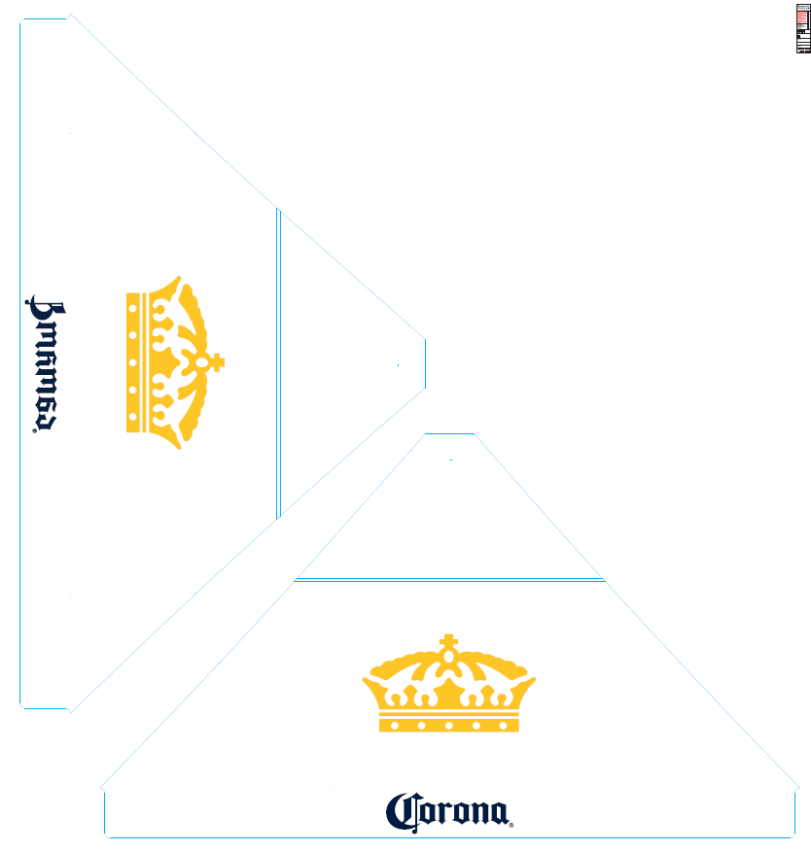
Corona, Lowenbrau
Corona 4x4 - 16 pcs
Corona 1.8m 20 pcs – according to above design
Lowenbrau 4x4 – 15 pcs

Slide 6
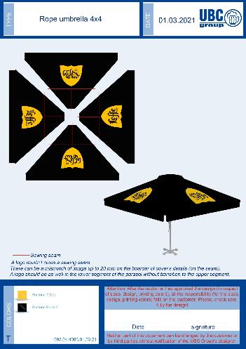
Leffe (Parasol and only Tent)
4x4 - 20 pcs
4x4 only TENT- 8 pcs

Slide 7
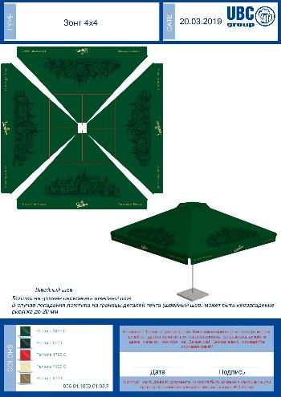
Staropramen (3X3 Tulip parasols)
3x3 Tulip- 10 pcs (According to shown design)

